Slide 1



ORIGINAL MEDICARE VS. MEDICARE ADVANTAGE
z
KNOW
YOUR
FACTS
Open Enrollment Is Oct. 15 – Dec. 7

Slide 2

KNOW YOUR FACTS
Original Medicare vs. Medicare Advantage
AGENDA
  Definitions
  Components of Medicare
  Original Medicare vs. Medicare Advantage
  Understanding Medicare Advantage
  Before making my Medicare decision

Slide 3

DEFINITIONS
Original Medicare - is a health plan that has two parts: Part A (hospital insurance) and Part B (medical insurance) and is managed by the federal government. This is the typical Medicare insurance most are familiar with.
Medicare Advantage - Medicare Advantage (Part C) is an alternative way to receive your Medicare Part A and Part B benefits through a Medicare-approved private insurance company.

Slide 4

Medicare Part | Description | 2026 Costs
Part A (Hospital Insurance) | Helps cover inpatient care in hospitals, skilled nursing care, hospice care and home health care. | $0 Monthly Premium in most cases. $1,736 deductible per benefit period for the first 60 days. *
Part B (Medical Insurance) | Covers services from physicians and other health care providers, outpatient care, home health care, durable medical equipment, and preventive services such as vaccines and wellness visits. | Monthly Premium $203 (or higher depending on income). $283 Annual Deductible. Generally, 20% coinsurance for most Part B-covered services after the deductible.
Part D (Drug Coverage) | Helps cover the cost of prescription drugs including many recommended shots or vaccines. | Varies by plan.
Medigap (Original Medicare Supplemental Insurance) | Extra insurance you can buy to help pay for your share of costs in Original Medicare. | Varies by plan.
COMPONENTS OF ORIGINAL MEDICARE
To get the comprehensive set of benefits, you may need all elements.
*please reference Medicare.gov for definition of benefit period.

Slide 5

Medicare Part | Description | Costs
Part C (Medicare Advantage) ** Note: You receive Parts A and B, but you will receive those benefits now through the MA plan. Some MA plans also include Part D | Medicare-approved plan from a private insurance company that offers an alternative to Original Medicare for health and drug coverage. Medigap generally cannot be used with a Medicare Advantage plan. | Varies by plan.
Part D (Drug Coverage) | Helps cover the cost of prescription drugs including many recommended shots or vaccines | Varies by plan.
Medicare Advantage plans can carry hidden risks, especially for people with major
health issues.
COMPONENTS OF MEDICARE ADVANTAGE

Slide 6

ORIGINAL MEDICARE VS. MEDICARE ADVANTAGE
There are significant differences in the way you’ll use Medicare depending on whether you pick Original Medicare or Medicare Advantage.

Slide 7

THE FIVE MAIN DIFFERENCES
1. Going to the Doctor
Original Medicare | Medicare Advantage
See any provider that accepts Original Medicare. No referrals needed. It’s your choice. | Many MA plans use limited provider networks, and some require a primary care provider, referrals, or prior authorization for certain services.
2. Covered Care
Original Medicare | Medicare Advantage
Most medical services are covered, but the program doesn’t cover routine dental, vision and hearing care. | Receive all medical services covered by Original Medicare, but some plans may include additions such as dental, vision, hearing and gym memberships.

Slide 8

THE FIVE MAIN DIFFERENCES
3. Network
Original Medicare | Medicare Advantage
Only two percent of physicians are NOT participating in the Original Medicare Network. This means you can choose to see most any physician and have access to care anywhere in the United States. | Based upon limited networks that are usually self-contained.
4. Costs
Original Medicare | Medicare Advantage
While you may pay a premium, deductible and coinsurance, your out-of-pocket costs may be more predictable. | Risk of surprise out-of-pocket costs that may quickly build up if you get sick.

Slide 9

THE FIVE MAIN DIFFERENCES
5. Approvals and Authorizations
Original Medicare | Medicare Advantage
Rarely require authorizations and approvals for any medical care. | In 2026, 99% of MA enrollees are in plans that require prior authorization for some services. It's especially common for inpatient hospital stays (97%), SNF (95%), Part B drugs (94%), and home health (90%). https://www.kff.org/medicare/medicare-advantage-in-2026-premiums-out-of-pocket-limits-supplemental-benefits-and-prior-authorization/?utm_source=chatgpt.com

Slide 10

UNDERSTANDING MEDICARE ADVANTAGE
Savings in your retirement years sound appealing until you are faced with denials, limited choices and hidden costs.

Slide 11

KNOW THE STATISTICS
99% of Medicare Advantage enrollees are in plans requiring prior authorization for some services.”
79% of the time, issues related to prior authorization process led to patients abandoning the physician’s recommended course of treatment.²
95% of physicians polled said authorizations delayed medical care.²
More than 1 in 4 physicians (29%) report that the prior authorization process has led to a serious adverse event for a patient in their care.²
4.1 million Medicare Advantage requested authorizations were denied in 2024.³
1. https://www.kff.org/medicare/medicare-advantage-in-2026-premiums-out-of-pocket-limits-supplemental-benefits-and-prior-authorization/?utm_source=chatgpt.com
2. https://www.ama-assn.org/system/files/prior-authorization-survey.pdf
3. Medicare Advantage Insurers Made Nearly 53 Million Prior Authorization Determinations in 2024 | KFF
Ask your physician and your hospital about the plan's network and prior authorization requirements before enrolling

Slide 12

KNOW THE RISKS
Strict network of providers.
Coverage does not always travel with you.
Possible high out-of-pocket costs.
Plan benefits change annually - they may terminate their relationship with Medicare on a given year, change premiums and/or benefits, and drop physicians in their networks during the year.
Constant need for referrals and approvals.

Slide 13

KNOW THE FACTS
Your federal Medigap Open Enrollment Period lasts six months beginning the first month you have Part B and are age 65 or older. Outside that period, options may be limited unless you have a guaranteed-issue right.
If you join a Medicare Advantage plan for the first time and decide to return to Original Medicare within the first 12 months, you may have a guaranteed right to purchase certain Medigap coverage.
Be Cautious – Medicare Advantage is not Medigap. With Medicare Advantage, you remain enrolled in Medicare Parts A and B but receive those benefits through a private Medicare Advantage plan. Medigap supplements Original Medicare and generally cannot be used with Medicare Advantage

Slide 14

WHAT DO I NEED TO DO BEFORE MAKING MY MEDICARE DECISION
  Ask yourself some important questions.
  Assess your current coverage.
  Know your Medicare options.
  Understand the Medicare Advantage plans’ network.
  Compare all out-of-pocket costs.
  Investigate managed care requirements.
  Call the insurance payer directly and ask questions.
  Consider the consequences of switching.
  Consult your physician and hospital.

Slide 15
ASK YOURSELF THESE IMPORTANT QUESTIONS:
  Am I comfortable with a health plan requiring referrals or prior authorization before it will cover certain services recommended by my physician?
  Do I travel outside my general home area?
  What medications do I take?
  How important are limits on my annual maximum out-of-pocket costs?
  What is the value of coverage of other possible services such as dental, hearing, and health club memberships?
  What is the value of having the convenience of staying with the Original Medicare option, knowing the services they cover, versus annually checking to ensure networks and coverage requirements are not changing?
  How do I feel about a Medicare Advantage plan challenging my physician's determination of care I need as reasonable and necessary?
  Will I be more likely to seek medical care if it is:
    Easily accessible and almost all physicians and facilities are available?
    Convenient and coverage is available for care in most geographic areas?
    Lower cost?

Slide 16

Senior Health Insurance Counseling for Kansas
  Senior Health Insurance Counseling for Kansas can help answer questions about Medicare, Medicare Advantage and other insurance options.
  Overall information can be found at: Senior Health Insurance Counseling for Kansas (SHICK) | Department for Aging and Disability Services (ks.gov).
  Each Kansas county has individuals in the area ready to help.
  To find the SHICK Coordinators in your area, go to: Locating Help | Department for Aging and Disability Services (ks.gov).
  Or call SHICK at (800) 860-5260.

Slide 17
CONTACT US
RUSSELL REGIONAL HOSPITAL
(785) 483-2323
rogene.gutshall@russellhospital.org
  200 S. Main Street, Russell, KS 67665
  www.russellhospital.org

Slide 18
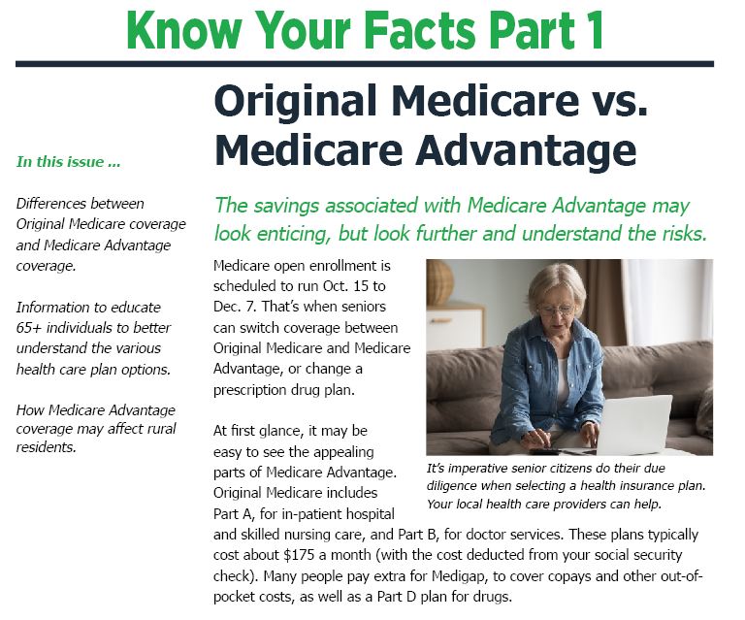

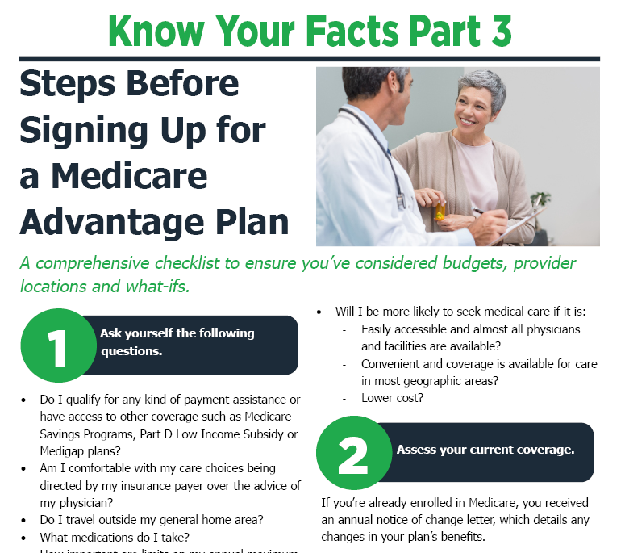

Don’t forget to download the Medicare: Know Your Facts Series.
Scan the QR code with your phone to download the Medicare: Know Your Facts series.
We are professionals who care about you.
Thank You

